Slide 1
Data Link Layer
Prepared By: Ms. Vidhi Pandya

Slide 2
Learning objectives
To understand design principle of Data Link Layer
To understand Different algorithms
To understand error and flow control
To understand different protocols

Slide 3
Location of Data link layer
Application Layer
Presentation Layer
Session Layer
Transport Layer
Network Layer
Service User
Data Link Layer
Service Provider
Physical Layer

Slide 4
Data link layer design issues
Issues
Providing a well-defined service interface to network layer
Dealing with transmission error
Regulating flow of data so that slow receivers are not swamped by fast senders

Slide 5
Relationship between packets and frames
Continue …..
Sending Machine
Receiving Machine
Packet
Packet
Frame
Header
Payload Field
Trailer
Header
Payload Field
Trailer

Slide 6
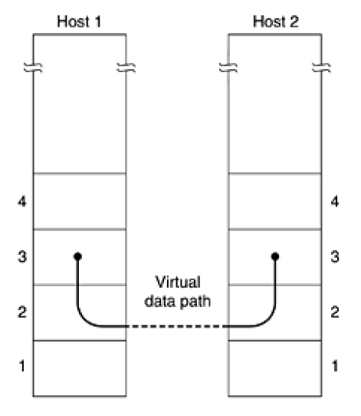
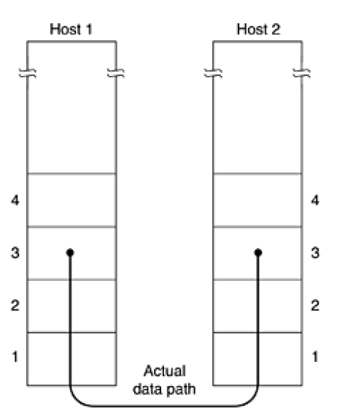
Services provided to network layer
Continue …..
Virtual Communication
Actual Communication

Slide 7
Continue …..
Services
Unacknowledged Connectionless Service
Acknowledged Connectionless Service
Acknowledged Connection-oriented Service
Note: Services offered can vary from system to system

Slide 8
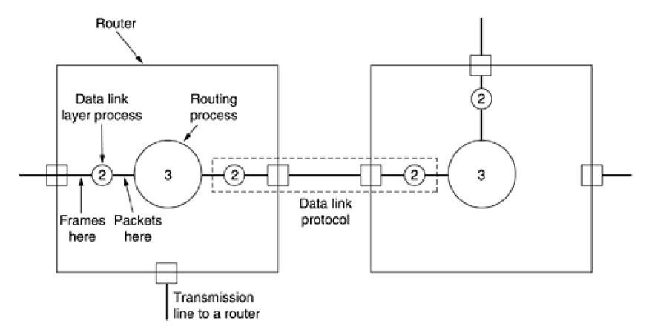
Continue …..
Location of Data Link Protocol

Slide 9
Framing
Continue …..
DLL uses services provided by Physical Layer
Physical Layer – Raw Bit Stream
Create frames by breaking bit stream
Computes Checksum value
Compare checksum at receiver side

Slide 10
Continue …..
To identify the starting and ending of frames
Problem
Four Methods:
Character Count
Flag bytes with byte stuffing
Starting and Ending flags with bit stuffing
Physical layer coding violations

Slide 11
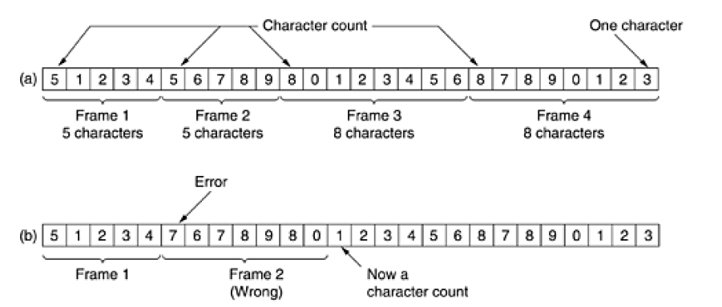
Character count Method
Continue …..

Slide 12
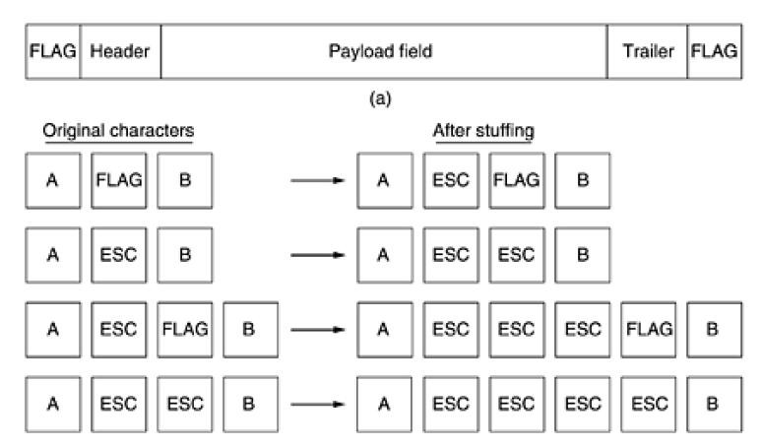
Flag bytes with byte stuffing
Continue …..

Slide 13
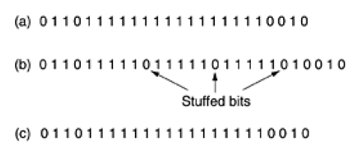
Starting and ending flags, with bit stuffing
Continue …..
Original Data
Data as they appear on line
Data as they are stored at receiver's memory

Slide 14
Physical layer coding violations
Continue …..
Only applicable to n/ws in which encoding on physical medium contains redundancy
Some LANs encodes 1 bit of data – 2 physical bits
1 bit – high-low pair
0 bit – low-high pair

Slide 15
Error control
Continue …..
Acknowledgement – positive or negative
For negative ack – retransmit the frame
For frame loss or ack loss – put timer
For duplication – put sequence number

Slide 16
flow control
Continue …..
Feedback based flow control
Rate based flow control

Slide 17
Reference Book: Computer Networks 4th edition Andrew s. tanenbaum

